Slide 1
Expressions
Presented By S.R.Zameer

Slide 2
What is an Expression?
In any programming language, if we want to perform any calculation or to frame a condition etc., we use a set of symbols to perform the task. These set of symbols makes an expression. An expression can be defined as follows...
An expression is a collection of operators and operands that represents a specific value.

Slide 3
Expression Types
Based on the operator position, expressions are divided into THREE types. They are as follows...
Infix Expression
Postfix Expression
Prefix Expression

Slide 4
Infix Expression
In infix expression, operator is used in between operands. The general structure of an Infix expression is as follows...
Operand1 Operator Operand2

Slide 5
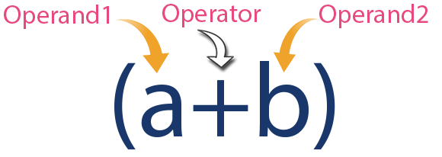
Example

Slide 6
Postfix Expression
In postfix expression, operator is used after operands. We can say that "Operator follows the Operands". The general structure of Postfix expression is as follows...
Operand1 Operand2 Operator

Slide 7
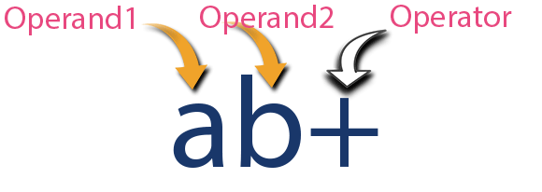
Example

Slide 8
Prefix Expression
In prefix expression, operator is used before operands. We can say that "Operands follows the Operator". The general structure of Prefix expression is as follows...
Operator Operand1 Operand2

Slide 9
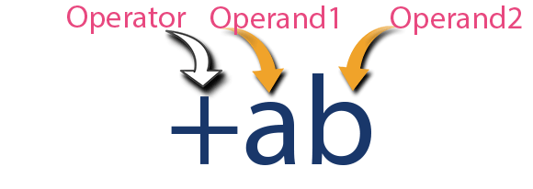
Example

